Slide 2
THE SHOW
MINExpo, owned and produced by the National Mining Association, brings professionals, experts and decision-makers from the global mining industry together. The show floor will feature mining products for safety, drilling, engineering, materials handling, training & HR and much more.
3
EXHIBIT HALLS
1,900+
INDUSTRY
SUPPLIERS
44,000+
MINING INDUSTRY
PROFESSIONALS
65,000+
SQUARE METERS OF MINING
EQUIPMENT AND SERVICES

Slide 4
ABOUT NMA
The National Mining Association (NMA) is the only national trade organization that serves as the voice of the U.S. mining industry and the hundreds of thousands of American workers it employs before Congress, the federal agencies, the judiciary and the media, advocating for public policies that will help America fully and responsibly utilize its vast natural resources.

Slide 5
WHERE THE INDUSTRY MEETS
Industry Sectors
Precious metals
Nonferrous metals
Ferrous metals
Coal
Industrial minerals
Stone mining & quarrying
Sand & gravel
Phases of Mining
Open-Pit Mining
Underground Mining
Processing/Preparation
Mine Site Development
Exploration & Surveying
Reclamation/Closure
Smelting & Refining

Slide 6
PRODUCT CATEGORIES
More than 1,900 exhibitors will showcase their latest equipment, services and technology
Assay Equipment
Auger Mining Equipment
Automation & Robotics
Blasting Agents
Coal Cutting Machines
Communication & Tracking Equipment
Drills- Dozers- Dredges
Electric Motors & Generators
Environmental Services
Exploration Equipment
Financial Services
Fuels & Additives
Global Positioning Systems
Heavy Equipment Transport
Industrial Fasteners- Jacks & Pulleys
Lighting Systems- Locomotives- Maintenance
Metals & Special Alloys
Noise Control Equipment
Pneumatic Tools- Process Controls
Refueling Systems
Roof Support Equipment
Safety Equipment
Security- Shovels
Tracked Vehicles- Water Treatment

Slide 7
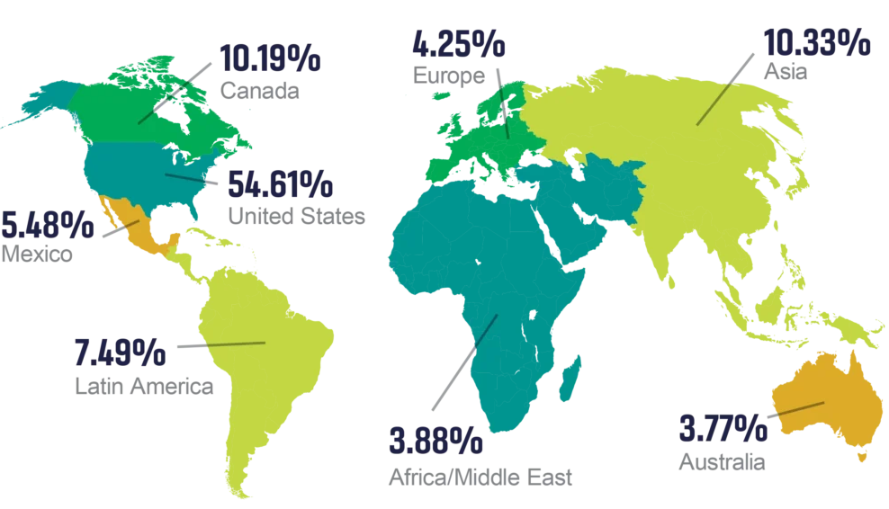
INTERNATIONAL ATTENDANCE
More than 16,000 MINExpo attendees are from countries outside the U.S.

Slide 8
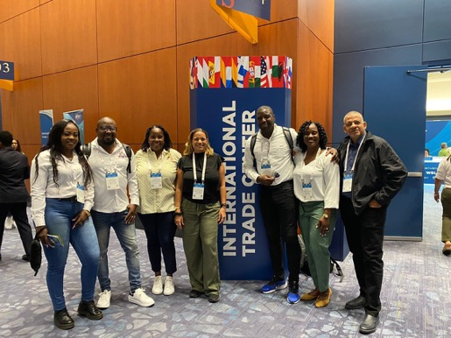
THE TEPP PROGRAM
MINExpo is a proud participant of the U.S. Department of Commerce’s Trade Event Partnership Program (TEPP).
Through the Department of Commerce’s network of U.S. Commercial Service (USCS) offices in U.S. Embassies and Consulates worldwide, trade specialists organize buyers’ delegations and bring them to selected trade shows in the United States, connecting them with U.S. companies.

Slide 9
BENEFITS FOR DELEGATIONS
Dedicated assistance from an in-country specialist
Complimentary registration, valued at up to $300 USD
Special discounts and help with hotel arrangements
Complimentary shuttle bus transportation
On-site support
Access to the International Business Center (IBC)
Personalized letters of invitation

Slide 10
LAS VEGAS
Is it any wonder Las Vegas is known as the trade show capital of the world? Make the most out of your stay while you come to MINExpo
World Class Dining, Shopping, and Gaming
Concerts and Entertainment
Day trips to the Grand Canyon, Hoover Dam, Antilope Canyon, and more!
Tour of some of the largest modern mines in the U.S. – Check Travel Nevada for more information.

Slide 11
INTERESTED IN JOINING A DELEGATION?
Contact __________ (fill with your contact information)
Check if you need a visa and start your application
Book your hotel and flight early
Discount room block rates are accessible through registration.
Follow MINExpo’s social media:
X: @MINExpoIntl
Facebook: MINExpo INTERNATIONAL
Instagram: minexpointl

Slide 12
THANK YOU!
We are looking forward to seeing you in Las Vegas

